Slide 1


Audio Classifier
Presenter – Kaushik Dahale
Guide – Prof. Rithik Raj

Slide 2
Audio Classification: Identifying audios
Audio classification is the process of identifying and categorizing different types of sounds from audio data. This involves using Deep learning techniques to recognize specific sounds such as dog barking, street noise, drilling, and gunshot sounds,etc.

Slide 3
Importance of identifying different sounds
1
Safety and Security
2
Urban Planning
Identifying gunshot and emergency sounds is crucial for public safety and security systems.
Understanding street noise helps planners mitigate noise pollution in urban areas.
3
Pet Behavior
4
Industrial Monitoring
Recognizing dog barking patterns can aid in understanding animal behavior and welfare.
Detecting drilling sounds is important for industrial equipment and safety measures.

Slide 4

Overview of the dataset :-
Audio Sources
Annotation Details
Data Size
The dataset includes audio recordings from various urban, industrial, and natural environments.
Each audio file is annotated with the specific sound type, providing labeled training data.
The dataset comprises a large collection of audio samples, providing
diverse training and testing examples, (8732,8)

Slide 5
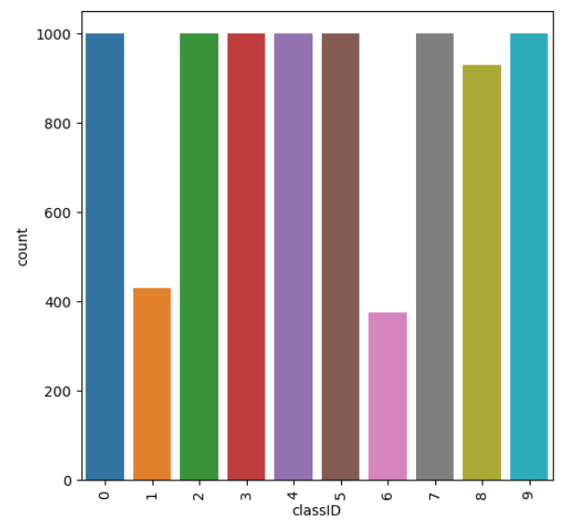
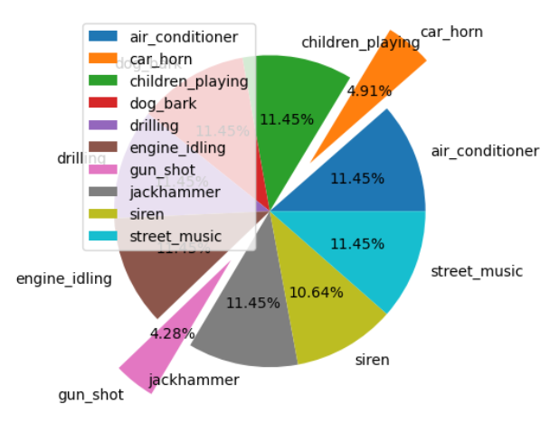
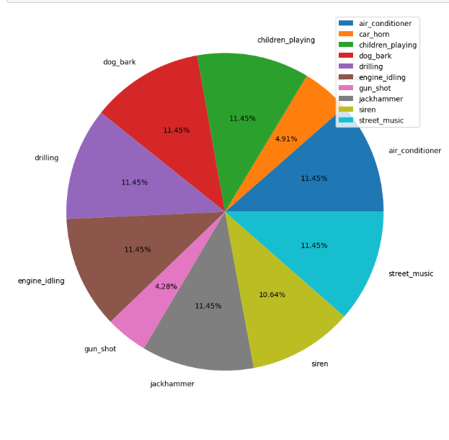
Questions asked in the project.
Which class_Id has less
count?
Which classes has less percentage?
What is the percentage of each classes?
Class 1 (car_horn)and class 6(gun_shot) has less number of counts.
car_horn & gun_shot classes has the less percentage which is less the 5%.
We can see the percentage of each class below

Slide 6


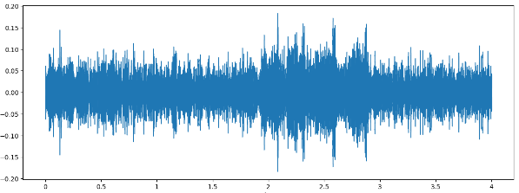

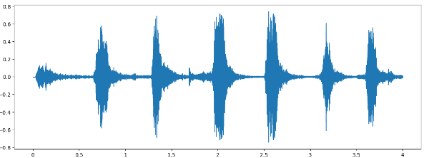

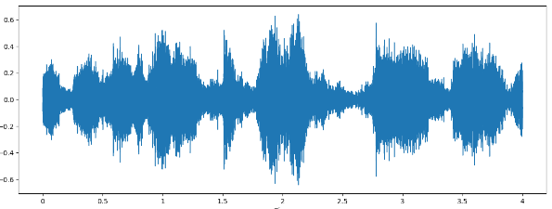
Some of the sound waves.
Sound wave of Bird sound.
Sound wave of Dog sound.
Sound wave of Street music.

Slide 7
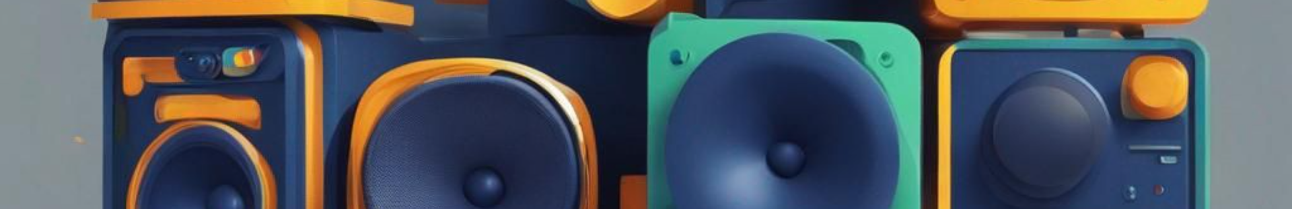
Conclusion and future work
Successful Sound Identification
1
Audio classification has shown promise in accurately identifying diverse sound types, paving the way for applications in security and environmental monitoring.
2
Future Enhancements
Further research aims to improve model robustness and real-time sound recognition capabilities for advanced practical usage.

Slide 8
Conclusion and future work
Successful Sound Identification
1
2
Future Enhancements
Further research aims to improve model robustness and real-time sound recognition capabilities for advanced practical usage.
Audio classification has shown promise in accurately identifying diverse sound types, paving the way for applications in security and environmental monitoring.

